Slide 1
LINEAR EQUATION
TWO VARIABLES

Slide 2
LINEAR EQUATION
An equation is a statement of equality of two algebraic polynomial involving one or more variables. The expression of the form Ax + B, where A and B are real numbers and A ≠ 0, is a linear polynomial and equation involving only linear polynomial are called linear equations.

Slide 3
SUBSTITUTION METHOD
From either equation find the value of one of the unknown in terms of the other.
Substitute the value thus found in the other equation.
Solve the resulting equation involving only one unknown.
Substitute the value of this unknown in the equation obtained in step first to find the other unknown.

Slide 4
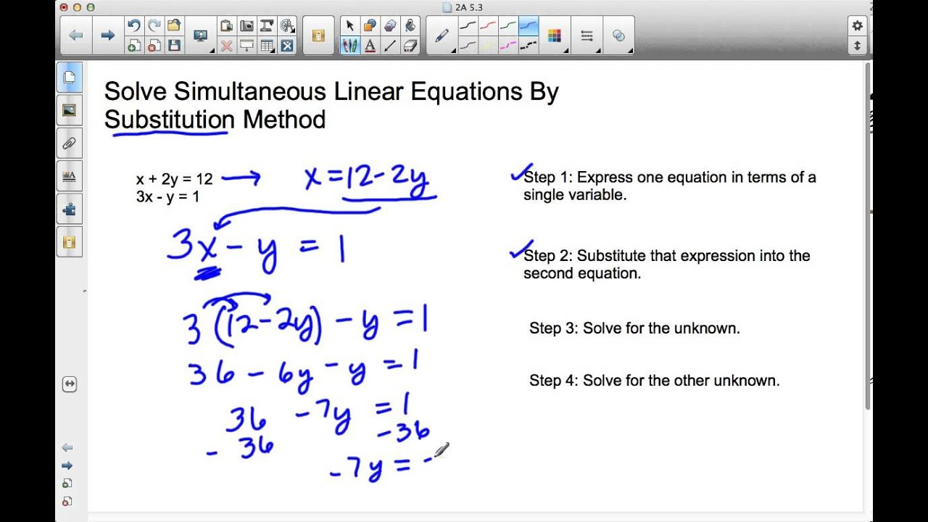

Slide 5
ELIMINATION METHOD
Multiply the coefficients of the equations with some constant so as to make the coefficients of one of the variables to be equal to the coefficients of same variable in other equation.
If the co-efficient of x or y have the same sign then subtract, if opposite signs, then add the resulting equations.
The resulting equation will have only one unknown y or x and can be solved easily.
Substitute value of unknown found in above step in either of the equation and find the other unknown.

Slide 6
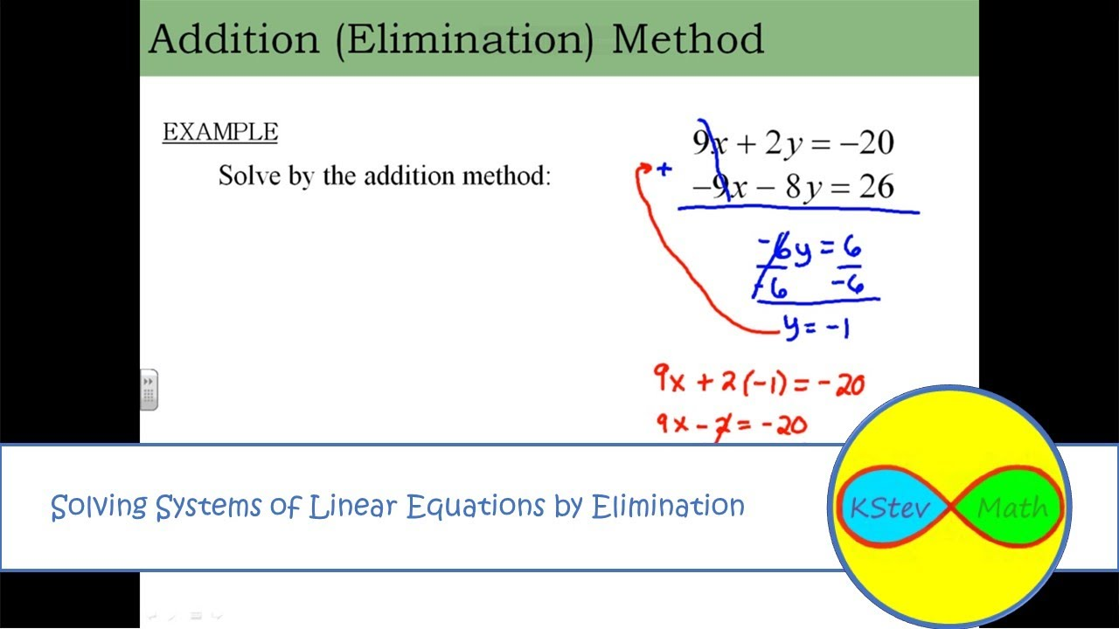

Slide 7
A man when asked how many hens and buffaloes he has told that his animals have 120 eyes and 180 legs. How many hens have he?
A) 20
B) 40
C) 30
D) 10

Slide 8
The sum of the two numbers is 11 and their product is 30, then the numbers are
A) 8, 3
B) 9, 2
C) 7, 4
D) 5, 6

Slide 9
If one number is thrice the other and their sum is 20, then the numbers are
A) 5, 15
B) 4, 12
C) 3, 9
D) 6, 18

Slide 10
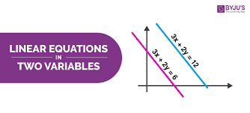
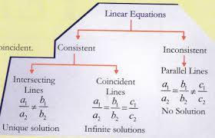
TWO EQUATIONS & SOLUTIONS

Slide 11
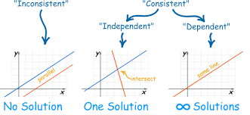
GRAPH

